Slide 1
11
M.DANI SETIAWAN
3SC5

Slide 2
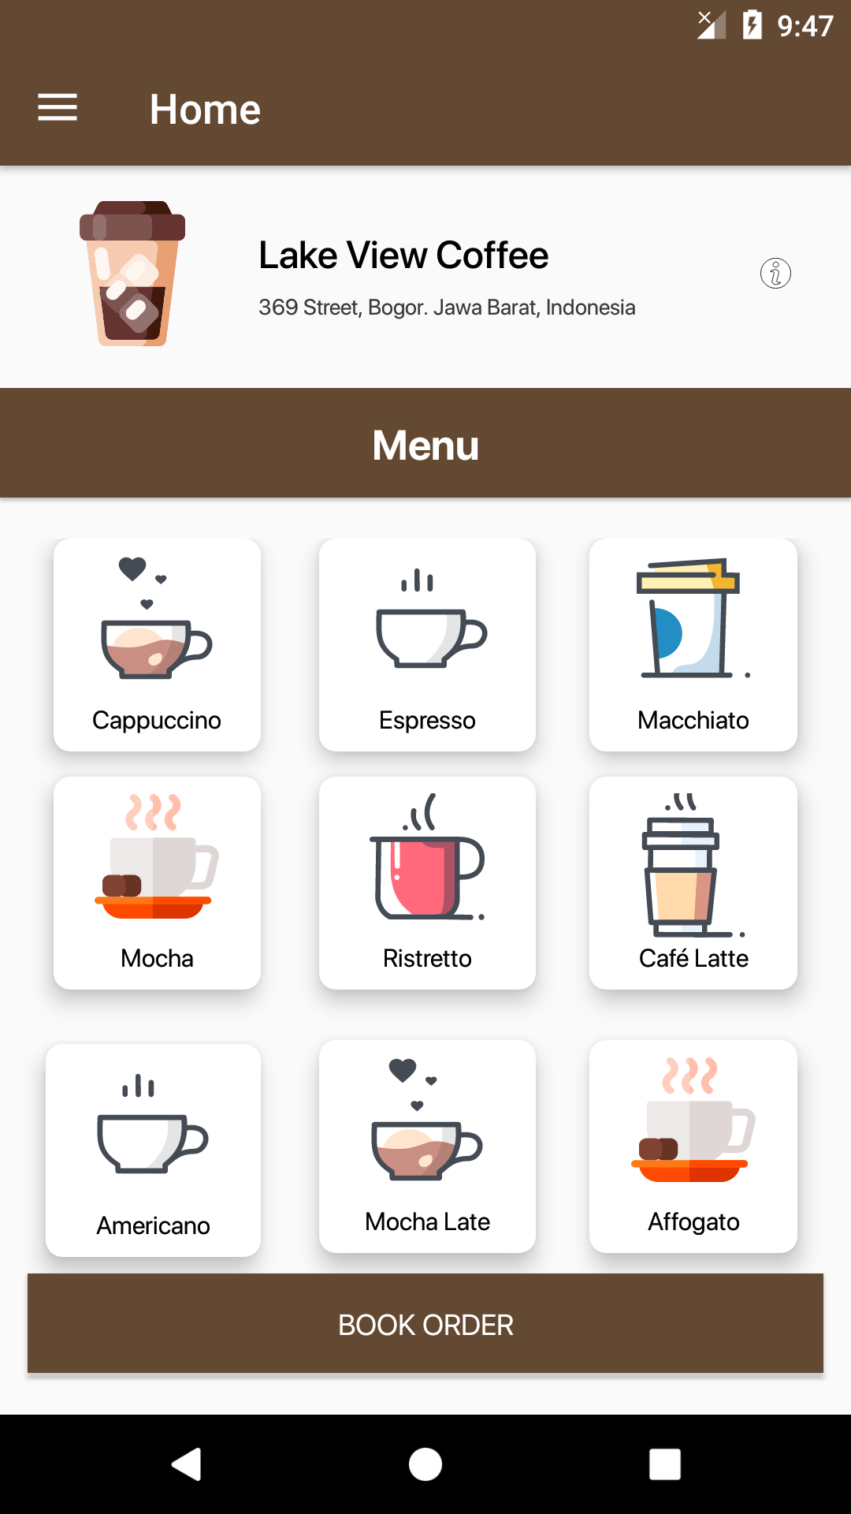
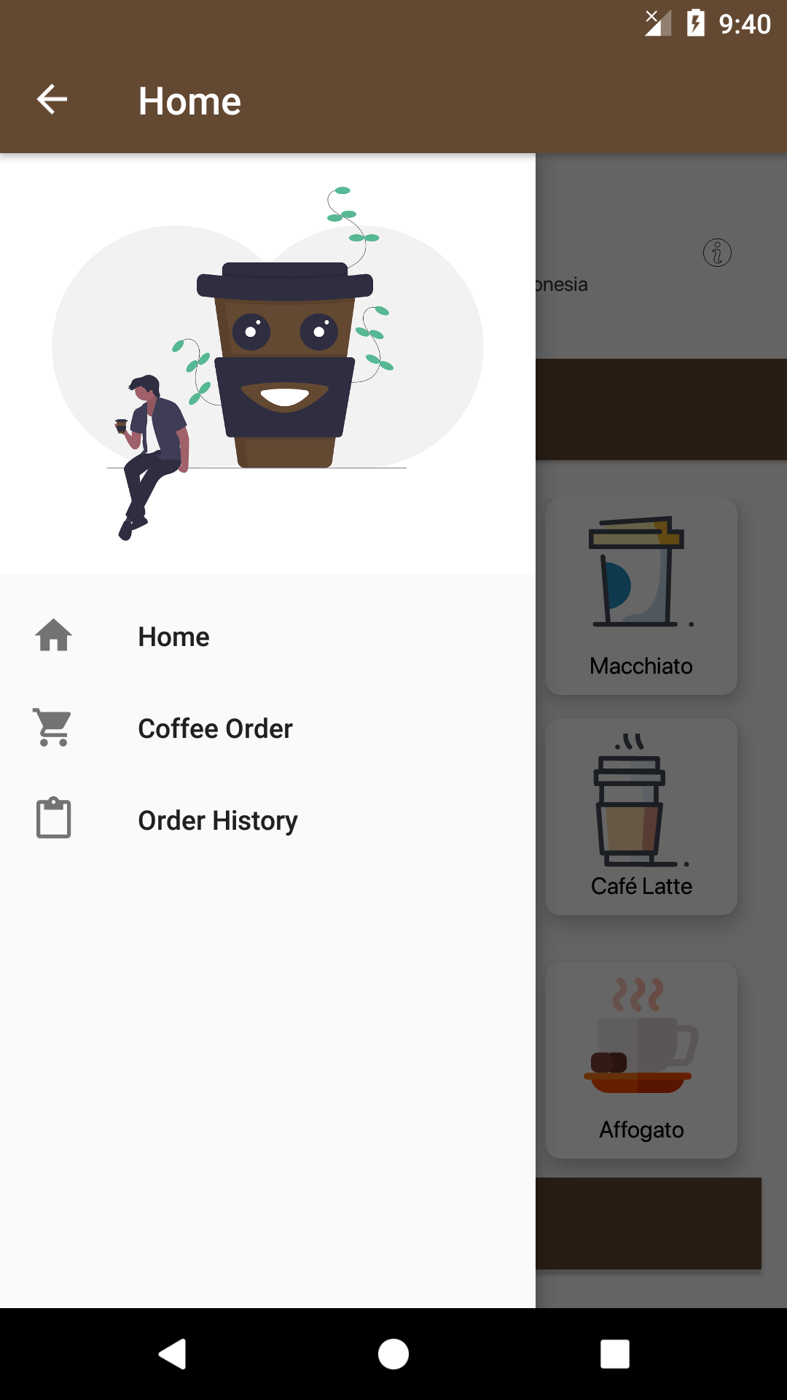
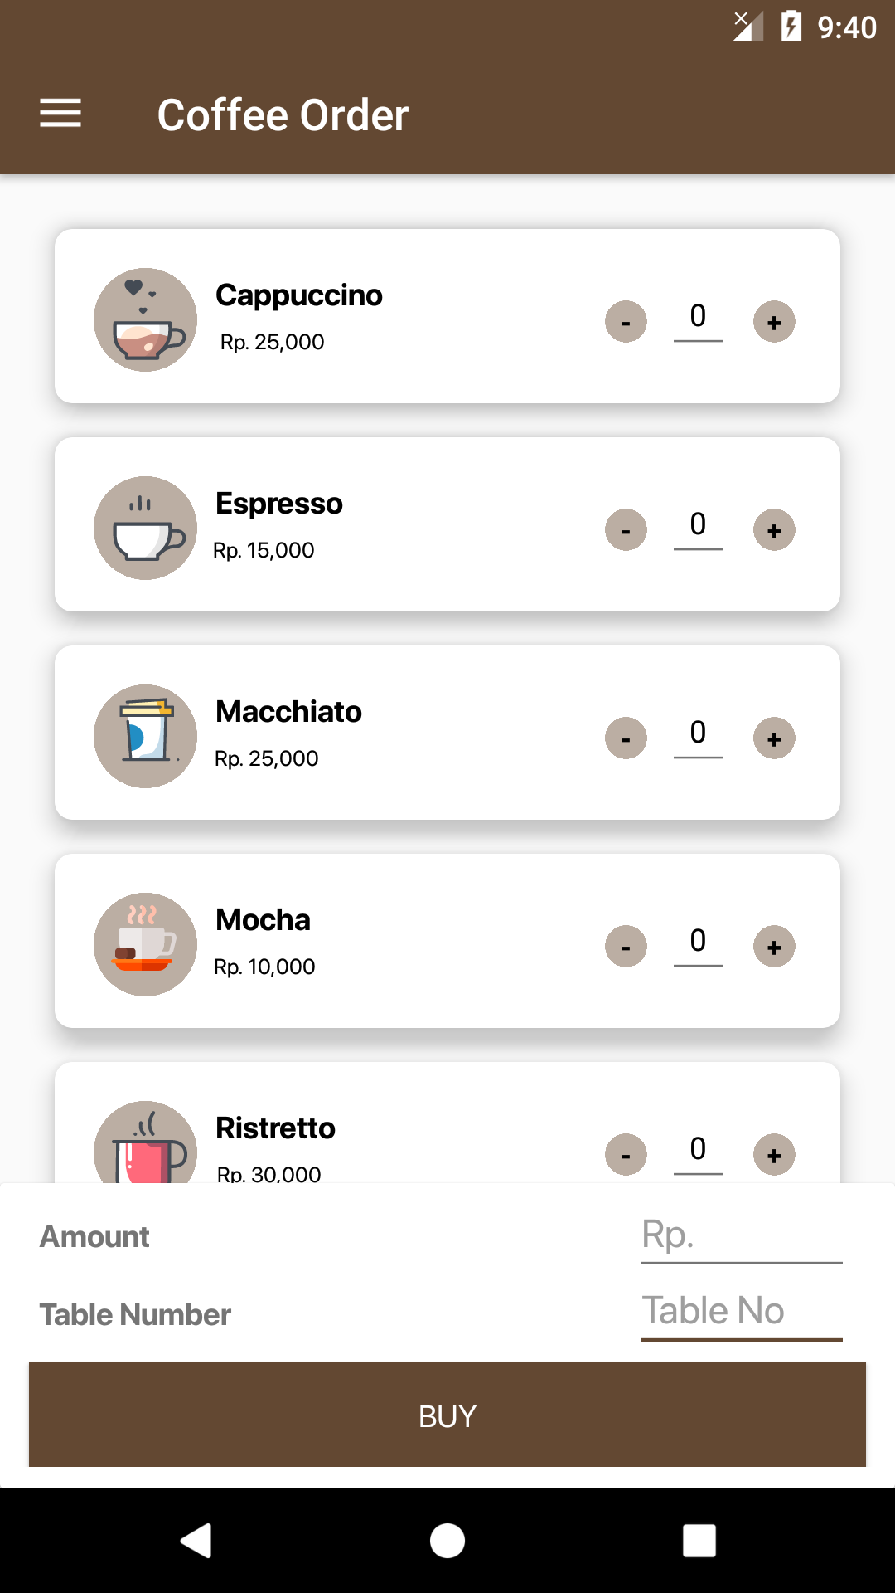
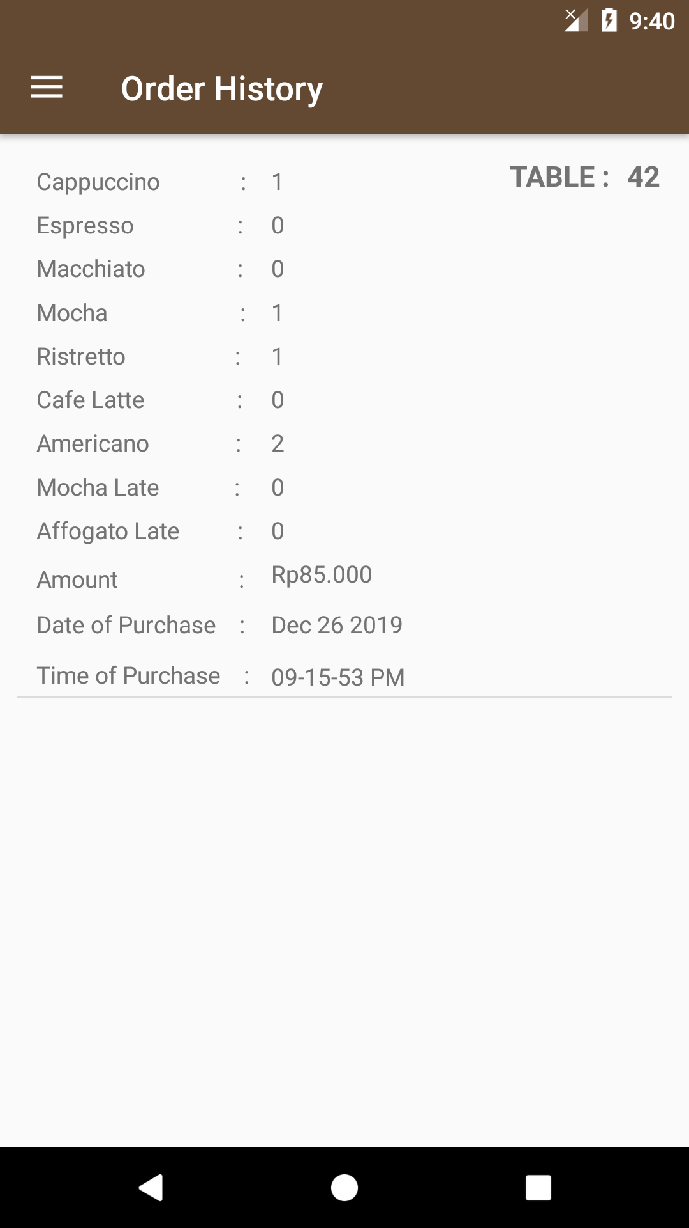
Lake View Coffee
Lake View Coffee is a coffee application to replace the menu book in ordering coffee, this application consists of three menus namely the Home menu, Order Coffee menu, Order History menu, in this home menu we can see about the coffee description, inside order menu we can order coffe by entering the available table number, in the order history menu we can see transaction details and change orders if something goes wrong.

Slide 3

DEMO PROJECT

